Slide 1


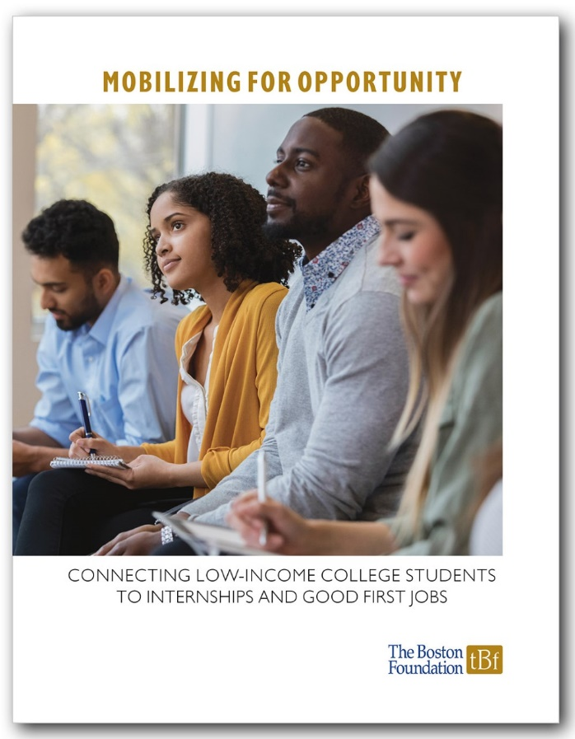
Mobilizing for Opportunity:
Connecting Low-Income College Students to Internships and Good First Jobs
Susan Goldberger, Burning Glass Technologies
Joseph McLaughlin, Boston Private Industry Council
Nancy Snyder, NextGen Talent
March 11, 2021

Slide 2
The Problem
Over 40% of all 4-year college graduates fail to land a good first job. (New York Federal Reserve Bank, 2020; Burning Glass/Strada Institute, 2018)
Low-income students get a much lower return for their education investment, earning half as much as their more affluent peers over the course of their career. (Upjohn Institute, 2016)

Slide 3
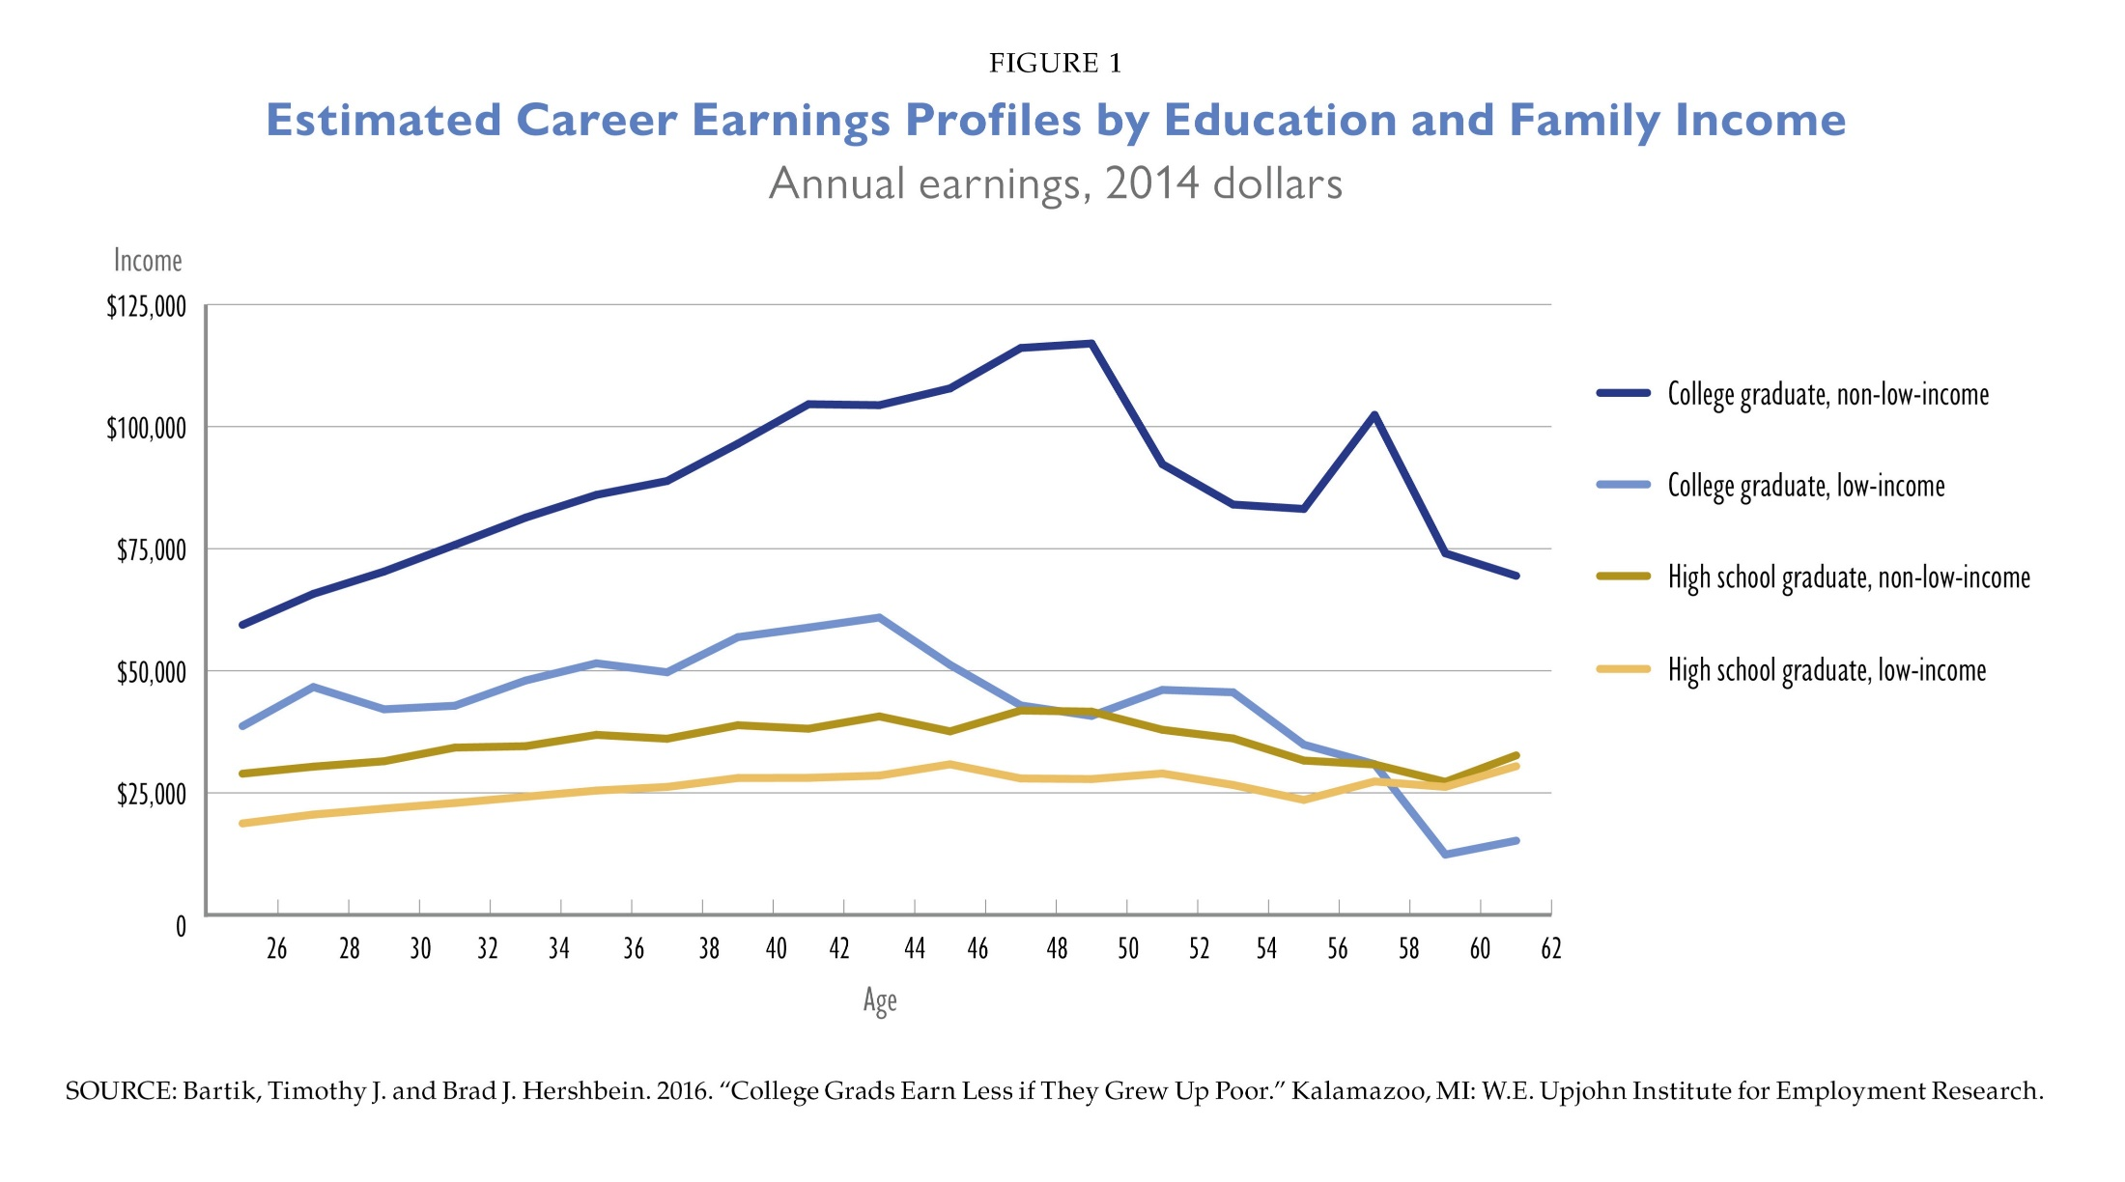

Slide 4
Goals of this Strategic Assessment
Analyze the post-college employment and earnings experiences of 4-year college grads from Boston and local colleges and identify factors associated with getting a good first job
Examine existing capacity for providing career-related supports
Identify successful/promising practices and strategies

Slide 5
Data Sources
First-year employment outcomes for 248 college graduates from Boston, who had been served by Bottom Line’s College Success program
BPS college enrollment, completion, and types of degrees earned
U.S. College Scorecard data on earnings of graduates by college and field of study at 7 public colleges that are top destinations for BPS graduates
Social Profile data of graduates from these 7 public colleges
Interviews with organizations and college departments that are brokering college internships and supporting students with post-college job placement

Slide 6
Bottom Line’s 2018 College Graduate Survey
Surveyed 288 college graduates (248 responded or 86%) to ask about their post-college education and employment plans.
The surveyed grads met income eligibility (<200% of FPL) while in high school in Boston area and participated in Bottom Line’s programming in college.
First Destination Career Outcomes of Boston Graduates 2017-2018
    66% of graduates who didn’t continue their education were employed in full-time career relevant roles.

Slide 7
Salary of First Full-Time Job After College,
Bottom Line and All New England College Graduates

Slide 8
Factors Associated With Better Outcomes
Field of Study
Internship participation in college
Comprehensive career counseling and job placement supports

Slide 9
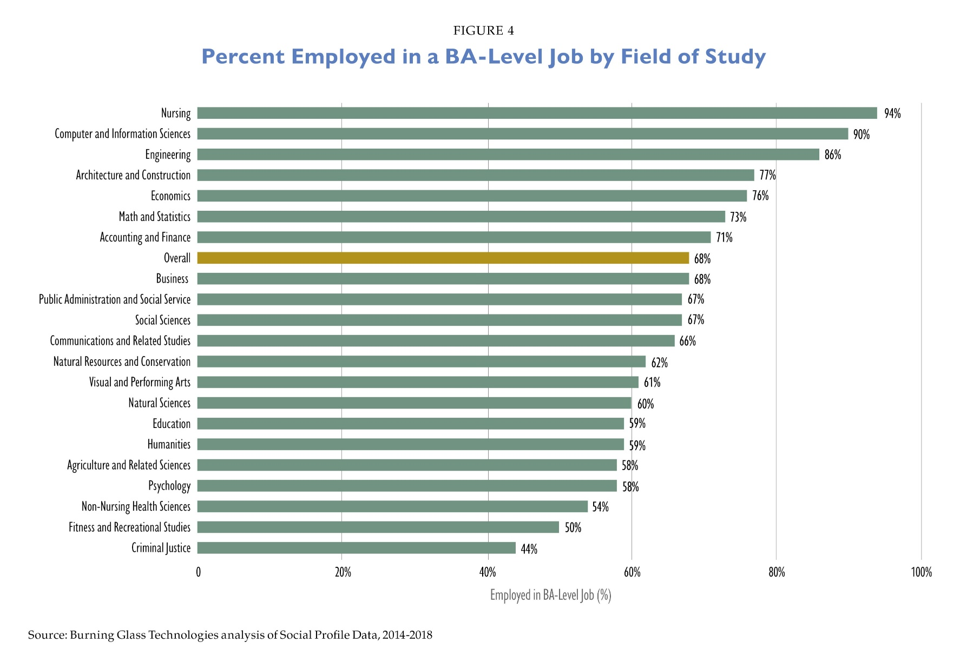

Slide 10
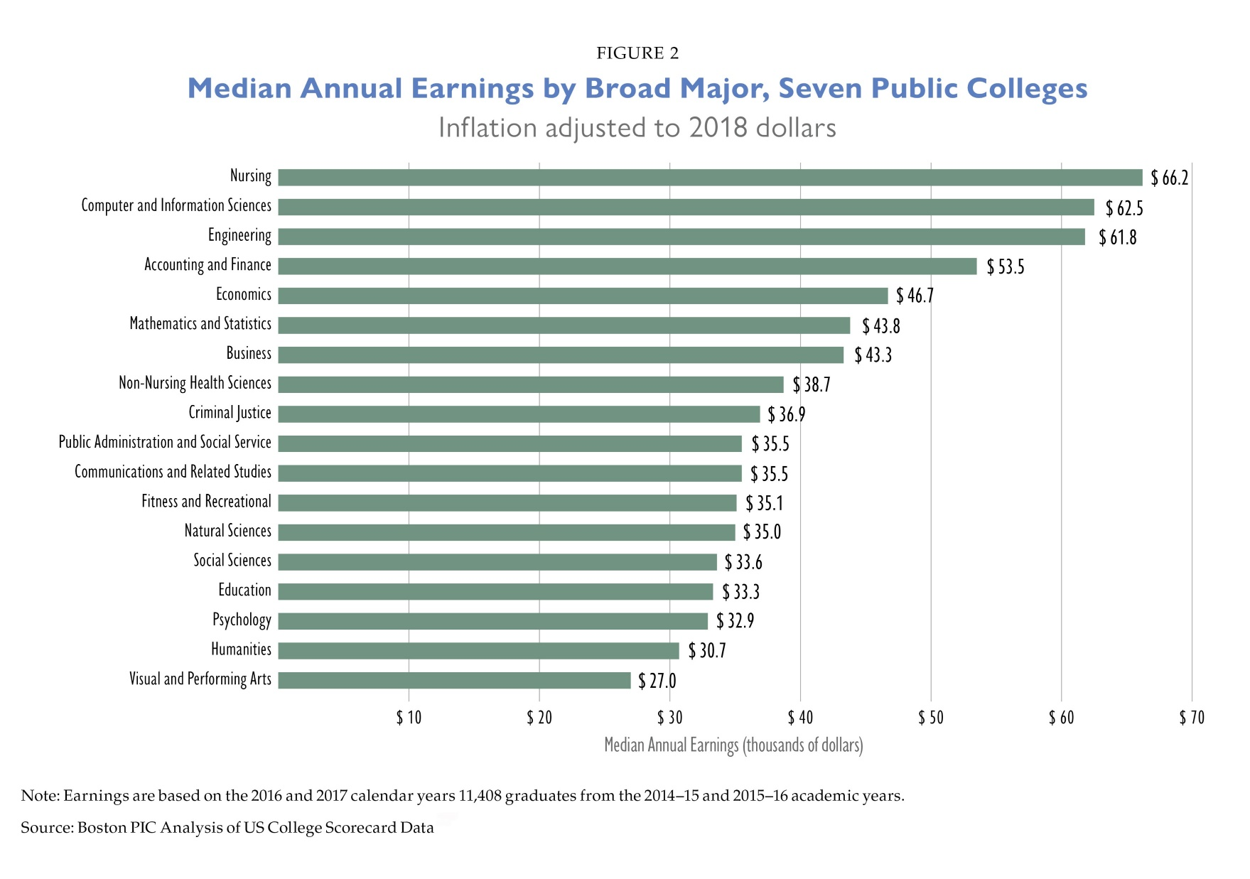

Slide 11
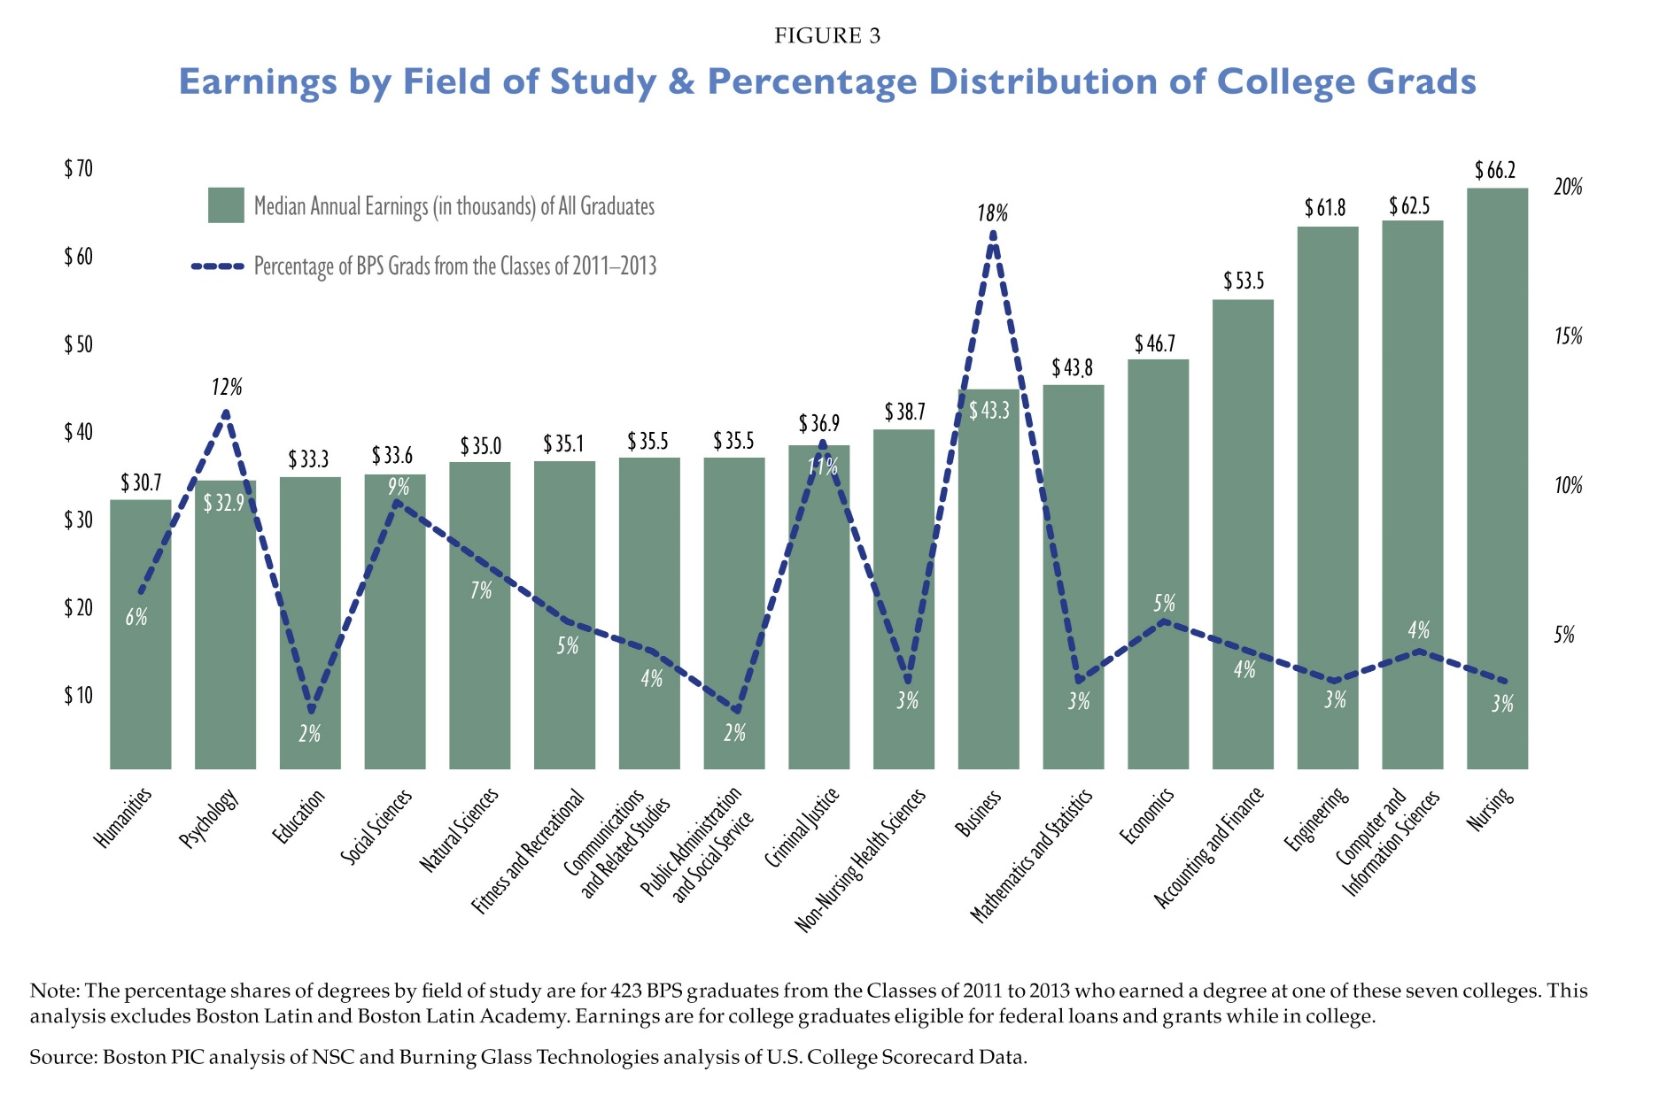

Slide 12
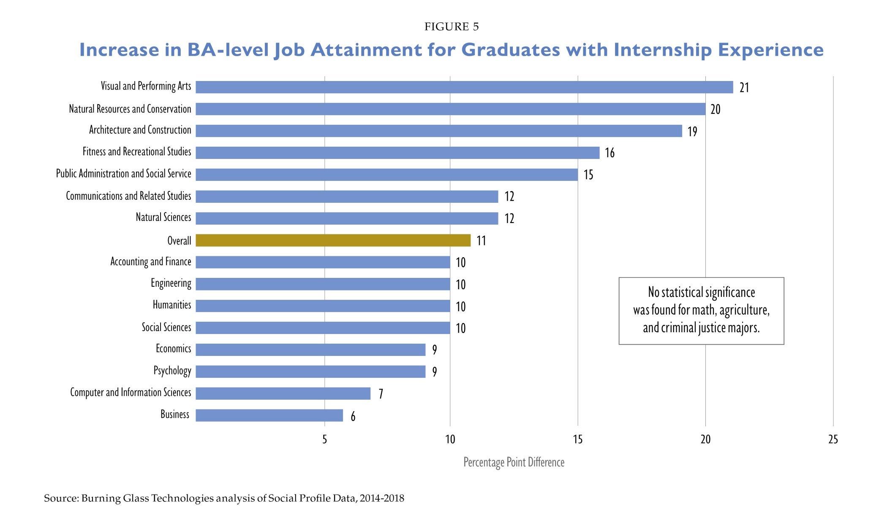

Slide 13
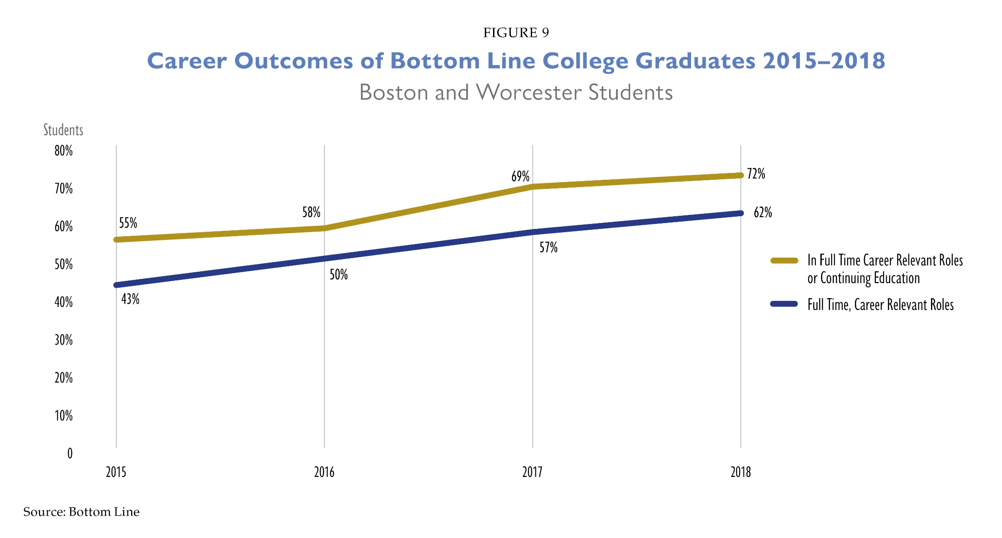
*Delivery of Career Connections Services Associated with
44% Boost in Employment Outcomes

Slide 14

Current Capacity to Provide Career-Related Supports

Slide 15
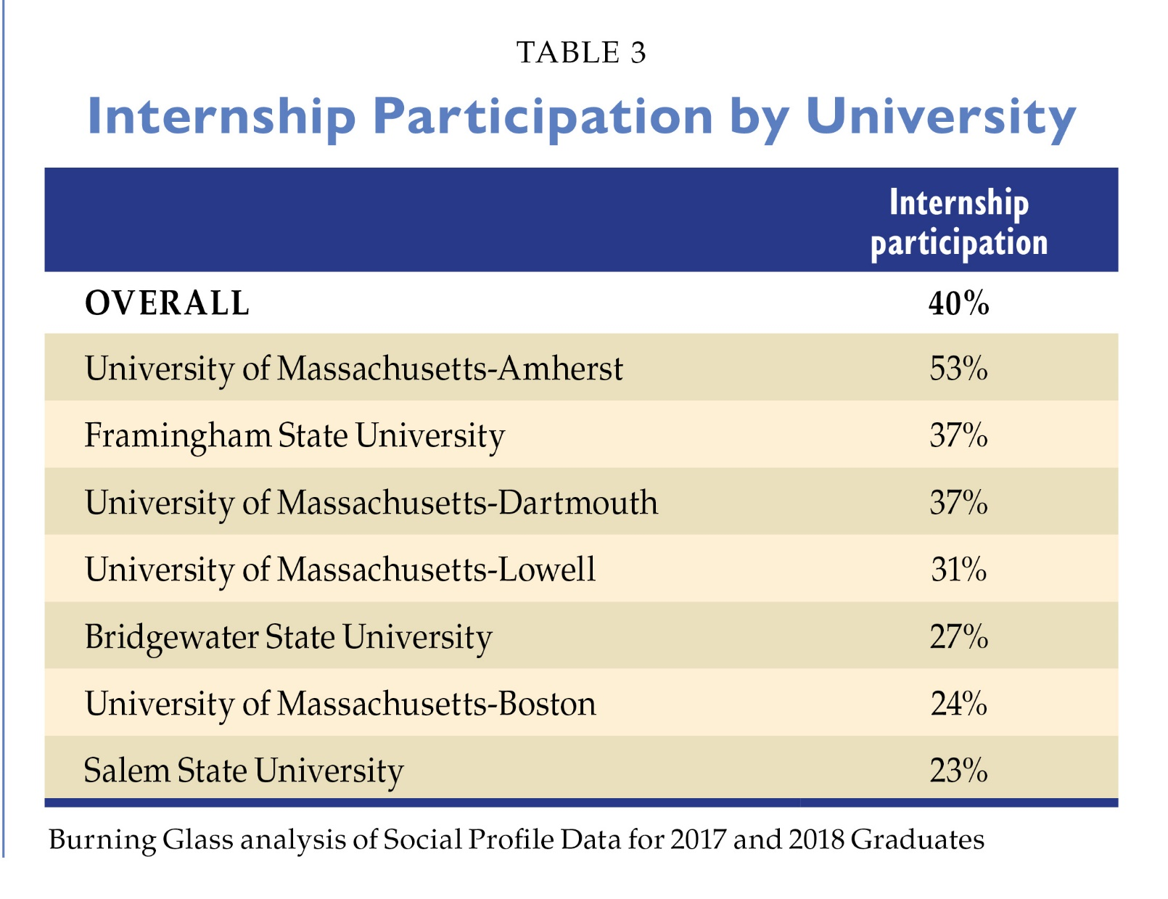

Slide 16
Gap in Potential Need for and Current Capacity for Multi-year Intensive Career Services Programming for Boston’s Class of 2023
Projected Gap: 780 students

Slide 17
Recommendations

Slide 18
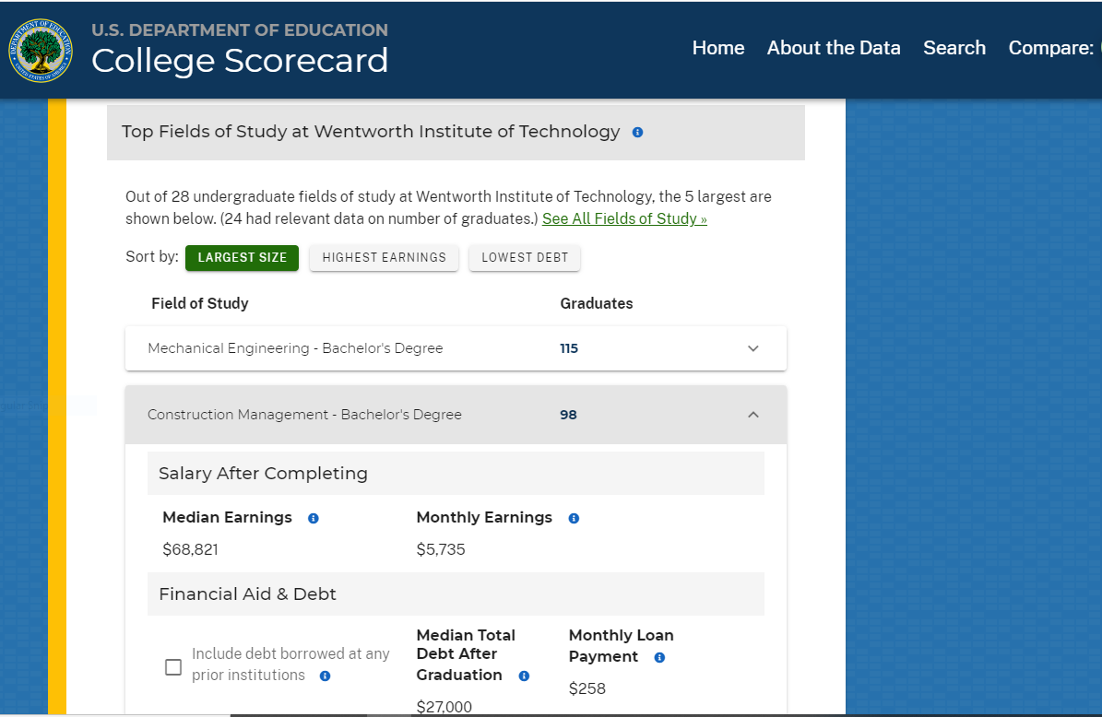
Empower Students to Incorporate Labor Market Information into Education Decisions

Slide 19
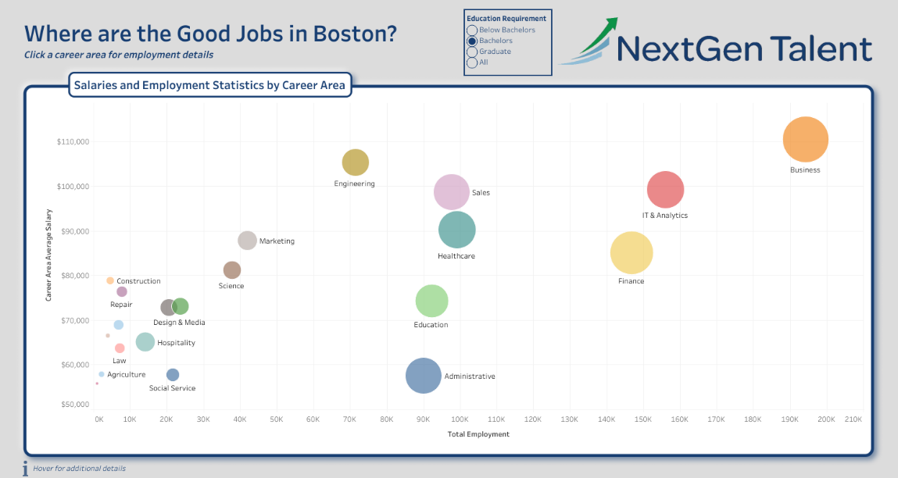
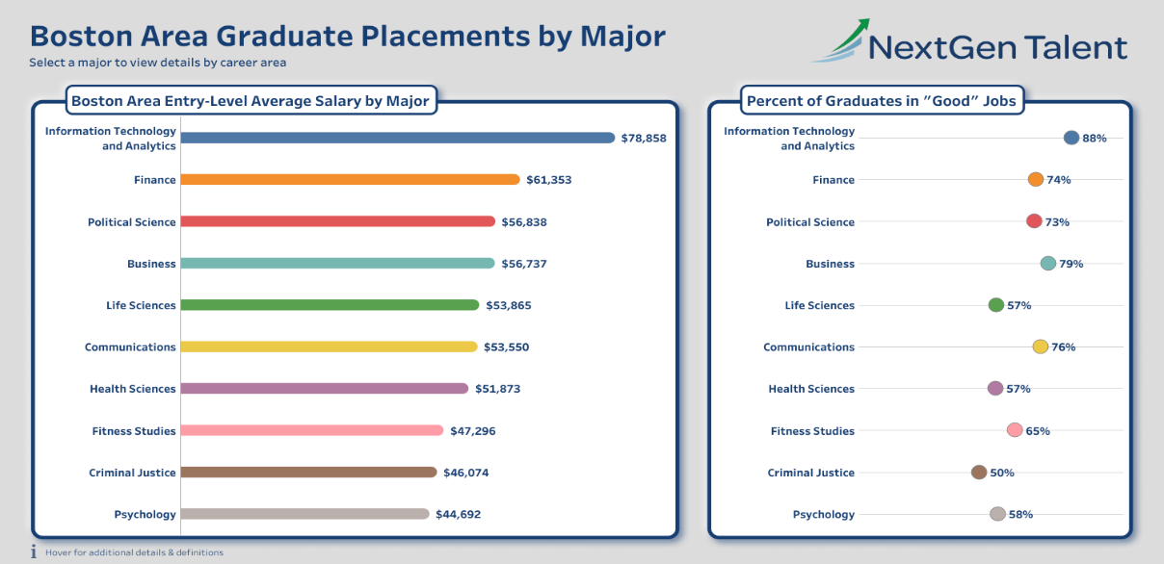
New Tools to Explore Boston Job Market and Outcomes by Major

Slide 20

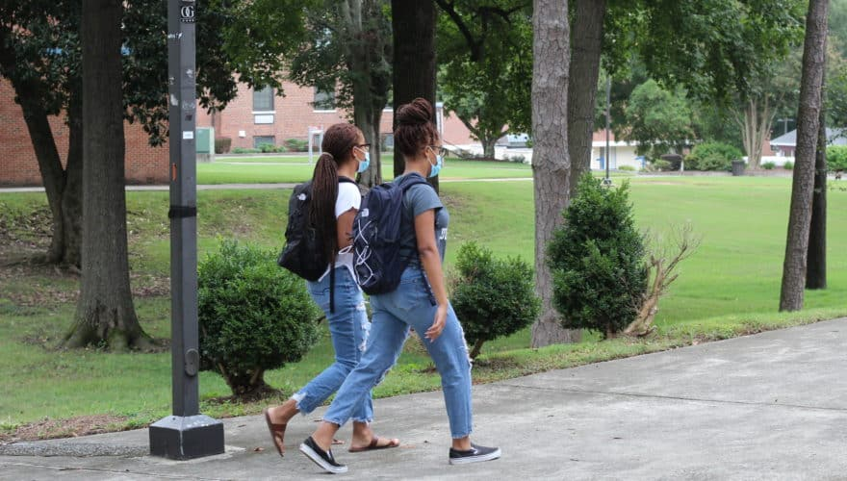
Help Liberal Arts Majors Acquire and Demonstrate Career-Relevant Experience and Skills

Slide 21

Extra Skills That Boost Value of Liberal Arts Degree
Burning Glass researchers have identified eight skill sets that liberal arts degree students can develop through coursework or internships to double their job prospects:
MARKETING
IT NETWORKING & SUPPORT
+ $336 premium
359,916 postings
+ $1,058 premium
66,429 postings
GRAPHIC DESIGN
SALES
+ $9,188 premium
134,090 postings
567,855 postings
COMPUTER PROGRAMMING
GENERAL
BUSINESS
+ $17,753 premium
52,822 postings
+ $11,144 premium
577,787 postings
SOCIAL MEDIA
DATA ANALYSIS & MANAGEMENT
+ $3,424 premium
399,577 postings
+ $12,703 premium
136,757 postings

Slide 22

Explore strategies to efficiently scale career coaching and internship/job placement services

Slide 23

Mobilize corporate leaders and industry associations to create more internship programs like Project Onramp to redress inequities in Boston job market
Expand participation of students from low-income backgrounds and students of color in existing large-scale internship programs

Slide 24
Thank you!

